Slide 1
Design and Analysis of Algorithms
CSC 413
LECTURE 3
Topic: Complexity Analysis and Performance Bounds
Lecture Note Presentation

Slide 2
Lecture outline
Complexity Theory
Best, Worst, and Average Case Analysis
Time-Space Trade-offs
Bubble Sort vs Insertion Sort
Assignment

Slide 3
Introduction to Complexity Analysis
Definition: Determines how resources (time and space) used by an algorithm grow with input size.
Purpose:
  Evaluate efficiency
  Predict performance
  Choose best algorithm

Slide 4
Types of Algorithmic Analysis
1. Best Case –
  The scenario where the algorithm performs the minimum number of operations
  It indicates the most optimistic performance of the algorithm.
  Example: For Linear Search, the best case occurs when the first element matches the key. → Time Complexity: O(1)
2. Average Case –
  The expected running time, assuming that all inputs of a given size are equally likely.
  It indicates the probable performance in real-world usage
  For Linear Search, average case occurs when the element is somewhere in the middle.→ Time Complexity: O(n/2) ≈ O(n)
3. Worst Case –
  The scenario where the algorithm performs the maximum number of operations.
  It indicates the maximum possible running time for any input of size n.
  Example: For Linear Search, the worst case occurs when the element is not in the list or is at the last position. → Time Complexity: O(n)

Slide 5
Comparison: Best, Average, and Worst Cases
Case | Meaning | Example (Linear Search) | Time Complexity
Best Case | Fastest possible execution | Element is first | O(1)
Average Case | Expected performance | Element in middle | O(n)
Worst Case | Slowest possible execution | Element not found | O(n)

Slide 6
Complexity Theory
It is also called computational complexity
It is a measure of amount of computing resources (space and time) that a particular algorithm consumes when it runs
Types of complexity:
  Time Complexity: Estimation of total CPU computation required to execute an algorithm. CPU computation can be defined as instruction executed by the CPU
  Space Complexity: Estimation of main memory space required to execute an algorithm.
    Space complexity measures the memory usage of a program
      What makes space complexity increase:
        Assigning variable
        Function calling and allocation
        Creating new data structures

Slide 7
How to Calculate Time and space Complexity of an Algorithm
Break the algorithm/function into individual operations
Calculate the frequency count of each operation
Add up the frequency count of each operation together
Remove the constants
Determine the highest order term.
Example 1;
    Sum = 0 1
    Arrx =]2,4,5,6,7] 1
    For(i=1; i<= n; i++) 1 + n + 1 + n= 2n + 2
    {
    sum += arrx[i] n
    }
    total = 1 + 1 + 2n +2 + n = 3n + 4 = 0(n)
Space complexity
Elements
Sum 1
arrx n
I 1
n 1
Total = 3 +n
Space complexity = 0(n)

Slide 8
How to Calculate Time and space Complexity of an Algorithm
Example 2;
    Sum = 0 1
    For(i=1; i<= n; i++) 1 + n + 1 + n= 2n + 2
    {
    for (j =1; j <= n; j++) n*(1+n+1+ n) =n*(2n + 2)= 2n² + 2n
    {
    sum += arrx[i] n*n= n²
    }
    }
    total = 1 + 2n +2 +2n² + 2n + n² = 3n² + 4n + 1 = 0(n²)
Space complexity
Elements
Sum 1
arrx n
I 1
n 1
Total = 3 +n
Space complexity = 0(n)

Slide 9

How to Calculate Time Complexity of an Algorithm
Example 3;
    Sum = 0 1
    For(i=1; i<= n; i+=2) 1 + $\frac{n}{2}$+$\frac{n}{2}$ = n + 1
    {
    sum += arrx[i] $\frac{n}{2}$
    }
    total = 1 + n +1 + $\frac{n}{2}$= n + $\frac{n}{2}$ + 2 = 0(n)
Space complexity
Elements
Sum 1
arrx n
I 1
n 1
Total = 3 +n
Space complexity = 0(n)

Slide 10

How to Calculate Time Complexity of an Algorithm
Space complexity
Elements
Sum 1
arrx n
I 1
n 1
Total = 3 +n
Space complexity = 0(n)
Example 4;
    Sum = 0 1
    For(i=1; i<= n; I *=2) 1 + $2^{x}$+ $2^{x−1}$
    {
    sum += arrx[i]${ 2}^{x}$
    }
    total = 1 + 1 + $2^{x}$+ $2^{x−1}$+${ 2}^{x}$= 2 + $\log_{2}{n\text{+ }\log_{2}{n}+1\text{+ }\log_{2}{n}}$ = 3 + 3$\log_{2}{n}$ = 0($\log_{2}{n}$)

Slide 11
Time-Space Trade-offs
Definition: A time-space trade-off refers to the relationship between the execution time and memory space used by an algorithm.
  Sometimes we can make an algorithm run faster by using more memory (precomputed data)
  Alternatively, we can use less memory at the cost of slower execution
Example 1: Lookup Tables
Compute every time → High Time, Low Space
Pre-compute → Low Time, High Space
Approach | Time | Space
Compute when needed | High | Low
Precompute & store | Low | High

Slide 12
Time-Space Trade-offs
Example2: Fibonacci series using Recursive and dynamic programming methods
  Recursive function calls itself twice for each value of n in the series.
    This leads to exponential time complexity: O(2ⁿ).
    Simple but inefficient for large n due to repeated recalculation.
  Dynamic programing stores (or "memorize") intermediate Fibonacci results so that each term is computed only once.
    Using extra memory to store intermediate results (memorization) greatly reduces computation time

Slide 13
Time-Space Trade-offs
Recursive method
Dynamic Programming Method
FIB-RECUR(n)
1. if n <= 1 then
2. return n
3. else
4. return FIB-RECUR(n - 1) + FIB-RECUR(n - 2)
FIB-DP(n)
1. create array F[0..n]
2. F[0] ← 0
3. F[1] ← 1
4. for i ← 2 to n do
5. F[i] ← F[i - 1] + F[i - 2]
6. return F[n]
Comparison of Recursive and Dynamic Programming methods
Method | Time | Space
Recursive | O(2ⁿ) | O(n)
Dynamic Programming | O(n) | O(n)

Slide 14
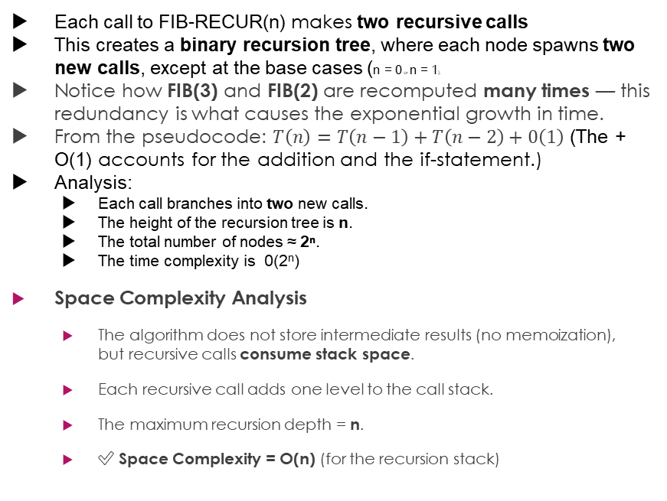
Recursive Method of Fibonacci Algorithm
Each call to FIB-RECUR(n) makes two recursive calls
This creates a binary recursion tree, where each node spawns two new calls, except at the base cases (n = 0 or n = 1).
Notice how FIB(3) and FIB(2) are recomputed many times — this redundancy is what causes the exponential growth in time.
From the pseudocode: $T\left(n\right)=T\left(n−1\right)+T\left(n−2\right)+0\left(1\right)$ (The + O(1) accounts for the addition and the if-statement.)
Analysis:
  Each call branches into two new calls.
  The height of the recursion tree is n.
  The total number of nodes ≈ 2ⁿ.
  The time complexity is 0(2^{n})
Space Complexity Analysis
  The algorithm does not store intermediate results (no memoization),
  but recursive calls consume stack space.
  Each recursive call adds one level to the call stack.
  The maximum recursion depth = n.
  ✅ Space Complexity = O(n) (for the recursion stack)
Example: Execution Tree for n = 5
FIB(5)
├── FIB(4)
│ ├── FIB(3)
│ │ ├── FIB(2)
│ │ │ ├── FIB(1)
│ │ │ └── FIB(0)
│ │ └── FIB(1)
│ └── FIB(2)
│ ├── FIB(1)
│ └── FIB(0)
└── FIB(3)
├── FIB(2)
│ ├── FIB(1)
│ └── FIB(0)
└── FIB(1)

Slide 15
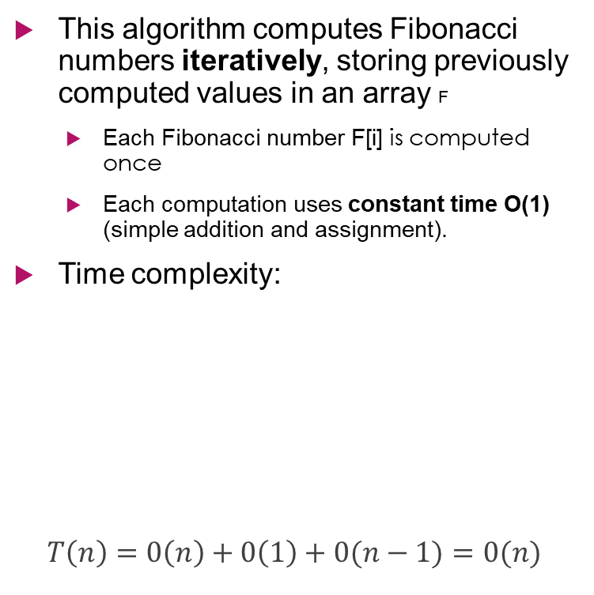
Dynamic Programming Method of Fibonacci Algorithm
This algorithm computes Fibonacci numbers iteratively, storing previously computed values in an array F
  Each Fibonacci number F[i] is computed once
  Each computation uses constant time O(1) (simple addition and assignment).
Time complexity:
$$T\left(n\right)=0\left(n\right)+0\left(1\right)+0(n−1)=0(n)$$
Space Complexity
The array F[0..n] stores n + 1 Fibonacci numbers.
Each number takes constant space (assuming fixed-width integers).
S(n)=O(n)
✅ Space Complexity = O(n)
Line | Operation | Cost | Number of Executions
1 | Create array | O(n) | 1
2–3 | Assign base cases | O(1) | 2
4–5 | Loop from 2 to n | O(1) per iteration | (n − 1) times

Slide 16
Performance Bounds
Upper Bound: O(f(n)) – Maximum runtime
Lower Bound: Ω(f(n)) – Minimum runtime
Tight Bound: Θ(f(n)) – Average runtime

Slide 17
Practical Example: Sorting Algorithms
Bubble sort
Insertion sort
Stabiliity in sorting algorithm:
  A sorting algorithm is said to be stable if it preserves the relative order of elements with equal keys (values
  If two elements A and B have the same value, and A appears before B in the original list,
  then A should also appear before B in the sorted list.

Slide 18
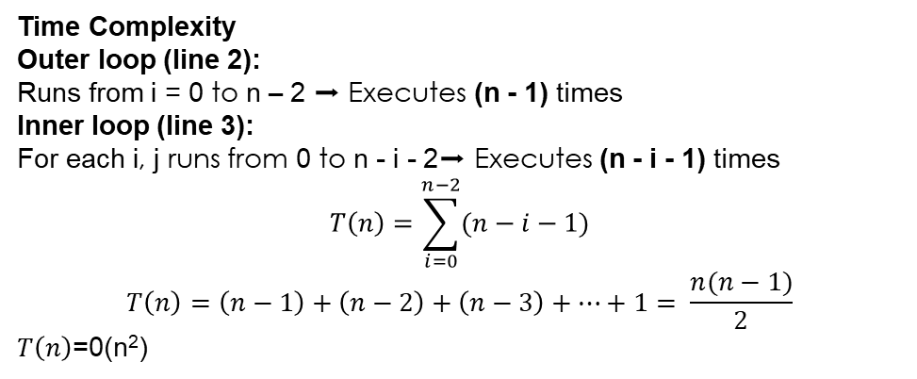
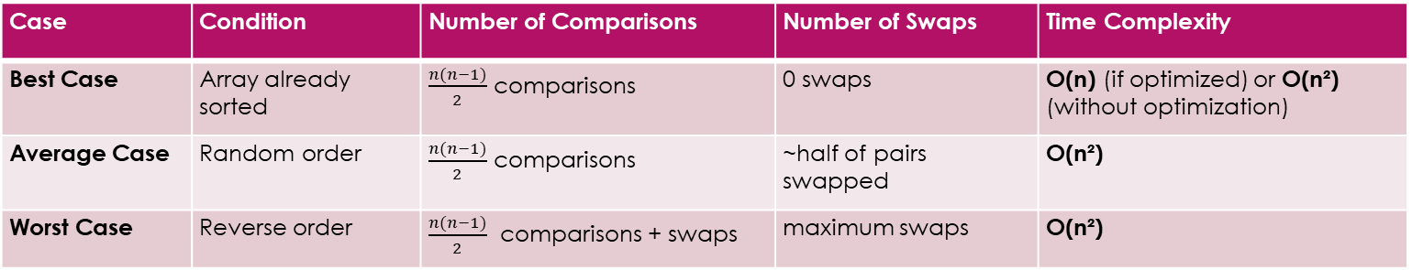
Bubble Sort - Concept
Repeatedly compare adjacent elements and swap if needed.
Time Complexity
Outer loop (line 2):
Runs from i = 0 to n – 2 ➡️ Executes (n - 1) times
Inner loop (line 3):
For each i, j runs from 0 to n - i - 2➡️ Executes (n - i - 1) times
$$T\left(n\right)=\sum_{i=0}^{n−2}{(n−i−1)}$$
$$T\left(n\right)=\left(n−1\right)+\left(n−2\right)+\left(n−3\right)+…+1= \frac{n(n−1)}{2}$$
$T\left(n\right)$=0(n²)
BUBBLE-SORT(A)
1. n ← length(A)
2. for i ← 0 to n - 2 do
3. for j ← 0 to n - i - 2 do
4. if A[j] > A[j + 1] then
5. swap A[j] and A[j + 1]
6. end for
7. end for
Case | Condition | Number of Comparisons | Number of Swaps | Time Complexity
Best Case | Array already sorted | $\frac{n(n−1)}{2}$ comparisons | 0 swaps | O(n) (if optimized) or O(n²) (without optimization)
Average Case | Random order | $\frac{n(n−1)}{2}$ comparisons | ~half of pairs swapped | O(n²)
Worst Case | Reverse order | $\frac{n(n−1)}{2}$ comparisons + swaps | maximum swaps | O(n²)

Slide 19
Bubble Sort - Concept
Space Complexity Analysis
Let’s evaluate memory usage:
The algorithm sorts in place — it only uses:
  A few variables (i, j, n, temporary swap variable)
  No extra arrays or data structures
✅ Auxiliary Space = O(1) (constant space)
Total space=O(n) (for the array)+O(1) (for variables)=O(n)

Slide 20
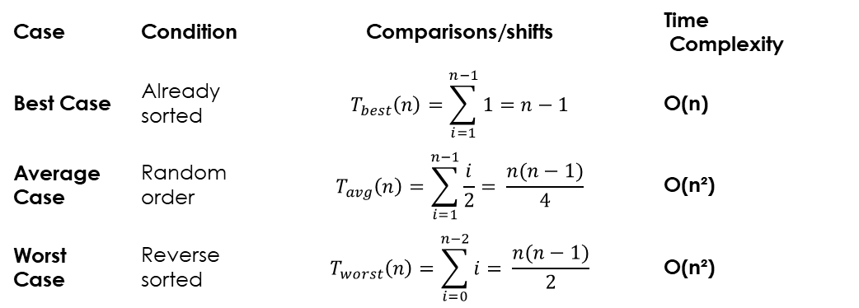
Insertion Sort - Concept
Insert elements into their correct positions one by one.
Example: [5,2,4,3] → [2,3,4,5]
The outer loop (line 2) runs from i = 1 to n - 1 → executes (n − 1) times.
The inner while loop (line 5–7) moves elements that are greater than the current key one position to the right.
The number of comparisons and shifts in the inner loop depends on the position where the key must be inserted.
INSERTION-SORT(A)
1. n ← length(A)
2. for i ← 1 to n - 1 do
3. key ← A[i]
4. j ← i - 1
5. while j ≥ 0 and A[j] > key do
6. A[j + 1] ← A[j]
7. j ← j - 1
8. end while
9. A[j + 1] ← key
10. end for
Case | Condition | Comparisons/shifts | Time Complexity
Best Case | Already sorted | $$T_{best}\left(n\right)=\sum_{i=1}^{n−1}{1=n−1}$$ | O(n)
Average Case | Random order | $$T_{avg}\left(n\right)=\sum_{i=1}^{n−1}{\frac{i}{2}= \frac{n(n−1)}{4}}$$ | O(n²)
Worst Case | Reverse sorted | $$T_{worst}\left(n\right)=\sum_{i=0}^{n−2}{i= \frac{n(n−1)}{2}}$$ | O(n²)

Slide 21
Practical Example: Sorting Algorithms
Comparison of Bubble sort and Insertion sort algorithms
Both algorithms are simple and in-place (no extra space).
Insertion Sort is usually faster for small or nearly-sorted lists.
                Bubble Sort is easier to implement but less efficient in practice.
Algorithm | Best Case | Average Case | Worst Case | Space | Stable
Bubble Sort | O(n) | O(n²) | O(n²) | O(1) | Yes
Insertion Sort | O(n) | O(n²) | O(n²) | O(1) | Yes

Slide 22
Optional Python Implementation
import time, random
def bubble_sort(A):
n = len(A)
For i in range(n):
for j in range(0, n - i - 1):
if A[j] > A[j + 1]:
A[j], A[j + 1] = A[j + 1], A[j]
return A
def insertion_sort(A):
for i in range(1, len(A)):
key = A[i]
j = i - 1
while j >= 0 and A[j] > key:
A[j + 1] = A[j]
j -= 1
A[j + 1] = key
return A
data = [random.randint(1, 1000) for _ in range(1000)]
start = time.time()
bubble_sort(data.copy())
print("Bubble Sort Time:", round(time.time() - start, 4), "sec")
start = time.time()
insertion_sort(data.copy())
print("Insertion Sort Time:", round(time.time() - start, 4), "sec")

Slide 23
Assignment
Compare Bubble and Insertion Sort:
1. Best, average, worst case
2. Time-space trade-off
3. Efficiency for datasets
4. Simplicity and stability

Slide 24
Summary
• Complexity analysis measures efficiency
• Best, average, worst cases vary by input
• Time-space trade-offs balance speed/memory
• Insertion Sort often faster on small or nearly sorted data

